Slide 1


Ahsanullah University of Science and Technology
Computer Science and Engineering Department
Emotionally Aware Chatbot EDAIC
Presented By-
Nowshin Rumali 160204107
Amin Ahmed Toshib 170104061
Rejone-E-Rasul Redoy 170104116
Mehedi Hasan Sami 170104118
Supervised By-
Mr. Md. Khairul Hasan
Associate Professor
Department of CSE, AUST

Slide 2


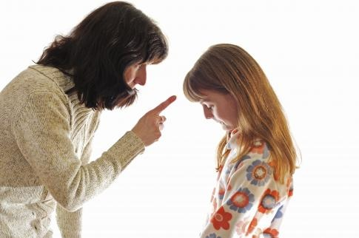
Motivation
“Our feelings are our most genuine paths to knowledge.” – Audre Lorde

Slide 3
Motivation (continued…)
As Yann LeCun said: “It is impossible to have intelligence without emotions”
Depressed or lonely human interaction
Customer feedback & Queries
Predicting box-office revenues from movie reviews
Public opinion regarding election results
Why?

Slide 4
Objectives
1
Joy
2
Surprised
3
Sadness
4
5
6
Anger
Love
Fear
7
Neutral
Creating an Interacting Chatbot
Text Analysis Emotion Detection
7 basic emotions
Machine Learning Techniques and Algorithms
Accuracy of Detected Emotions
Seven Emotions Predict

Slide 5
Purpose
An AI chatbot which can interact with human
A real-time emotion detection
Serves in business, gaming, psychological sessions

Slide 6
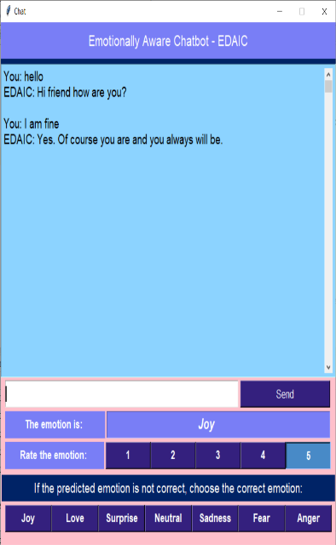

Introduction
Text
Analysis
Models
Performance
Analysis
Reply
Generate
Emotion
Predict
Chatbot – a computer program
Simulates human like conversation
Detecting and recognizing emotions through the expressions from sentences
Machine Learning algorithms used
Fig: AI Chatbot

Slide 7
Related Works
Gayatri Nair,Soumya Johnson,V. Sathya. Chatbot as a Personal Assistant. International Journal of Applied Engineering Research ISSN 0973-4562 Volume 13, Number 20 (2018) pp. 14644-14649
https://www.ripublication.com/ijaer18/ijaerv13n20_24.pdf
V V Ramalingam, A Pandian, Abhijeet Jaiswal and Nikhar Bhatia. Emotion Detection from Text. Published under licence by IOP Publishing Ltd, (2018) J. Phys.: Conf. Ser.1000 012027
https://iopscience.iop.org/article/10.1088/1742-6596/1000/1/012027/pdf
M. Balaji and N. Yuvaraj. Intelligent Chatbot Model to Enhance the Emotion Detection in social media using Bi-directional Recurrent Neural Network. (2019) J. Phys.: Conf. Ser. 1362 012039
https://iopscience.iop.org/article/10.1088/1742-6596/1362/1/012039/pdf
Yan Wang Jiayu Zhang Jun Ma Shaojun Wang Jing XiaoPing An Technology. Contextualized Emotion
Recognition in Conversation as Sequence Tagging. Ping An Technology (2020).
https://www.aclweb.org/anthology/2020.sigdial-1.23.pdf

Slide 8
Chatbot
Text
Preprocessing
Feature
Extraction
Testing
Dataset
Cosine Distance
And Reply
Generation
7 Models
Punctuation Remove
Tokenization
Lemmatization
Replace Emojis
Replace Contraction
Count Occurrence
TF-IDF
Support Vector Machine (SVM)
Logistic Regression
Random Forest Classifier
XGBoost Classifier
Multinomial Naive Bayes
Decision Tree Classifier
Multilayer Perceptron
Intent Prediction
Performance Measure
Cosine Distance measurement
Retrieve Reply from Dataset according to cosine similarity

Slide 9
Chatbot Dataset
Combination of 2 datasets
27 Unique Intents
3 Columns – Text, Reply, Intent
Contains Meaningful Replies
75-25 split
Dataset:
Chatbots Intent Recognition dataset
Context Free dataset

Slide 10
Emotion Detection
Text
Preprocessing
Feature
Extraction
7 Models
Testing
Dataset
Evaluation
Punctuation Remove
Tokenization
Stopwords Remove
Lemmatization
Count Occurrence
TF-IDF
Support Vector Machine (SVM)
Logistic Regression
Random Forest Classifier
XGBoost Classifier
Multinomial Naive Bayes
Decision Tree Classifier
Multilayer Perceptron
Performance Measure
Real Life Text Input
Emotion Detect

Slide 11
Emotion Dataset
7 Basic Emotions
2 Columns – Text, Sentiment
25000 Tweets
70-30 split
Reference Paper:
Emotion Detection from Tweets using AIT-2018 Dataset
Dataset:
Tweet Emotion

Slide 12

Text Preprocessing
Raw Text
Text: | ‘Reading books make me happy…’
Punctuation Remove: | Reading books make me happy
Tokenization: | [‘reading’, ‘books’, ‘make’, ‘me’, ‘happy’]
Stopwords Remove: | [‘reading’, ‘books’, ‘make’, ‘happy’]
Lemmatization: | [‘reading’, ‘book’, ‘make’, ‘happy’]
Preprocessed Text
Table - 1: Text Preprocessing Example
xD | Laugh
:) | Smile
:’( | Cry
Can’t | Cannot
I’ll’ve | I will have
We’ve | We have
Table - 2: Replace Emoji Example
Table - 3: Replace Contraction Example

Slide 13

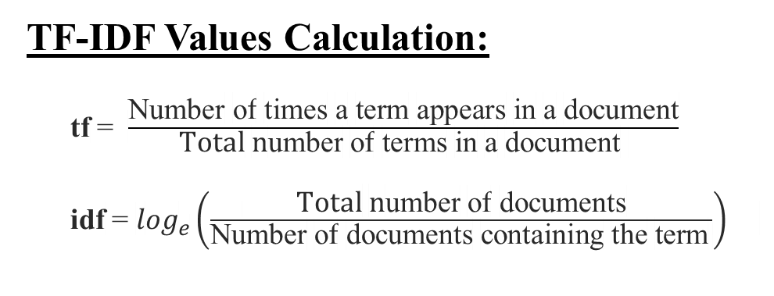
Feature Extraction
TF-IDF Values Calculation:
tf = $\frac{\text{Number} \text{of} \text{times} \text{a} \text{term} \text{appears} \text{in} \text{a} \text{document}}{\text{Total} \text{number} \text{of} \text{terms} \text{in} \text{a} \text{document} }$
idf = $\log_{e}\left(\frac{\text{Total} \text{number} \text{of} \text{documents}}{\text{Number} \text{of} \text{documents} \text{containing} \text{the} \text{term} }\right)$
Words from Documents | TF values |  |  | IDF values
 | Doc 1 | Doc 2 | Doc 3
Creative | 0 | 0 | 0.33 | log_{e}(3/1)
Feel | 0.5 | 0.16 | 0.33 | log_{e}(3/3)
Grab | 0 | 0.16 | 0 | log_{e}(3/1)
Greedy | 0 | 0.16 | 0 | log_{e}(3/1)
Humiliate | 0.5 | 0 | 0 | log_{e}(3/1)
Minute | 0 | 0.16 | 0 | log_{e}(3/1)
Need | 0 | 0 | 0.33 | log_{e}(3/1)
Post | 0 | 0.16 | 0 | log_{e}(3/1)
Wrong | 0 | 0.16 | 0 | log_{e}(3/1)
TF-IDF Example:
Document 1: I didn’t feel humiliated.
Document 2: I’m grabbing a minute to post I feel greedy wrong.
Document 3: I have been feeling the need to be creative.

Slide 14
Models
Multilayer
Perceptron
Decision
Tree Classifier
Logistic Regression
Seven Models
Support Vector Machine
Multinomial Naïve Bayes
Random Forest Classifier
XGBoost Classifier

Slide 15

Performance Metrics (Chatbot)
70.93
71.71
0.658
0.652
0.619
0.633
0.612
0.615
53.68
56.01
0.542
0.437
0.476
0.289
0.485
0.314
44.19
48.45
0.107
0.442
0.093
0.408
0.076
0.384
58.72
0.485
0.499
0.459

Slide 16
Prediction of Best Intent (Chatbot)
Input Text: Hi, How are you?
Predictions:
Models | Intent
Support Vector Machine (SVM) | Greeting
Logistic Regression | Greeting
Random Forest | Greeting
XGBoost Classifier | Greeting
Multinomial Naïve Bayes | Info
Decision Tree Classifier | Busy
Multilayer Perceptron (MLP) | Greeting
Final Prediction (Best Intent):
Greeting

Slide 17
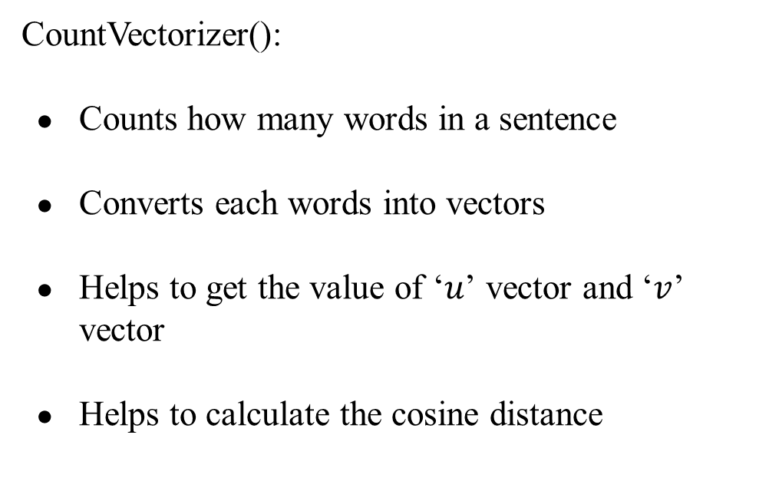
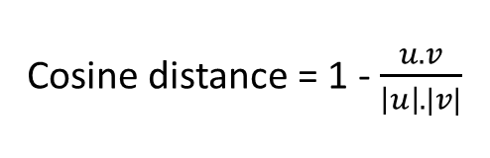
Cosine Distance
Formula:
CountVectorizer():
Counts how many words in a sentence
Converts each words into vectors
Helps to get the value of ‘$u$’ vector and ‘$v$’ vector
Helps to calculate the cosine distance
Cosine distance = 1 - $\frac{u.v}{\left|u\right|.|v|}$
The less the value of cosine distance, the more suitable the response is.

Slide 18
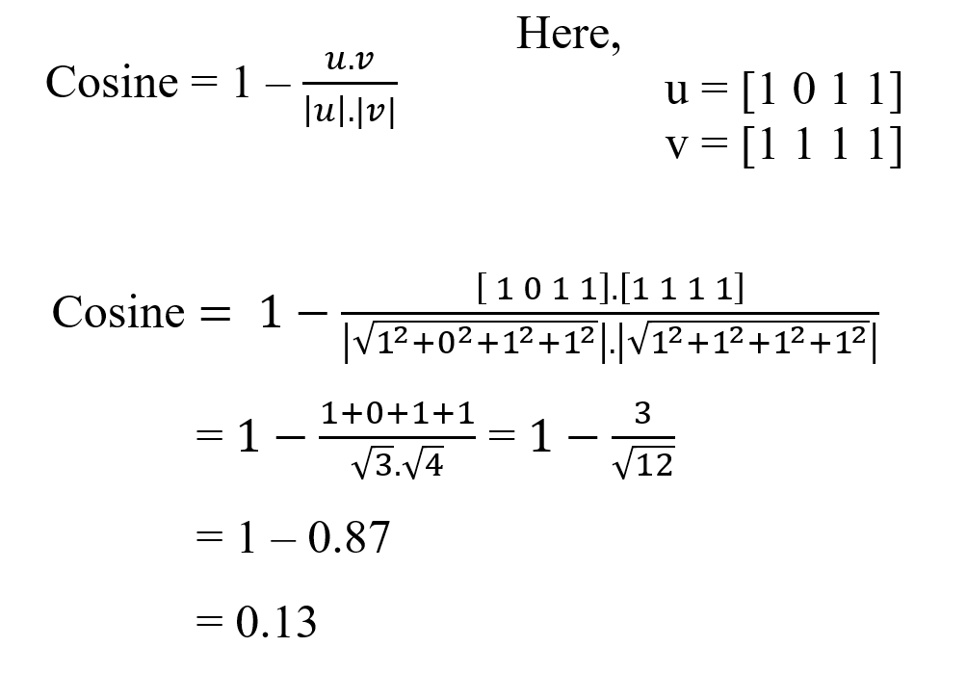
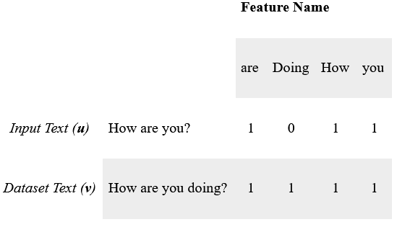
Cosine Distance

Slide 19
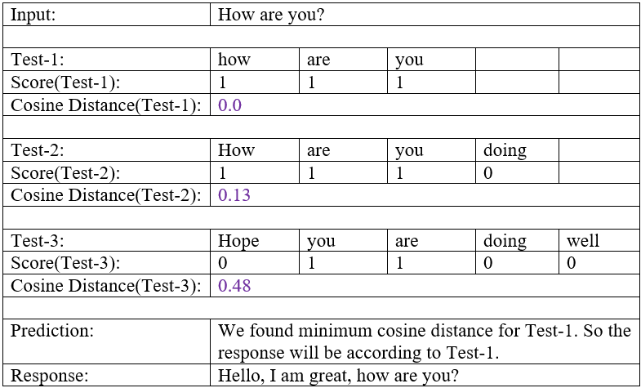
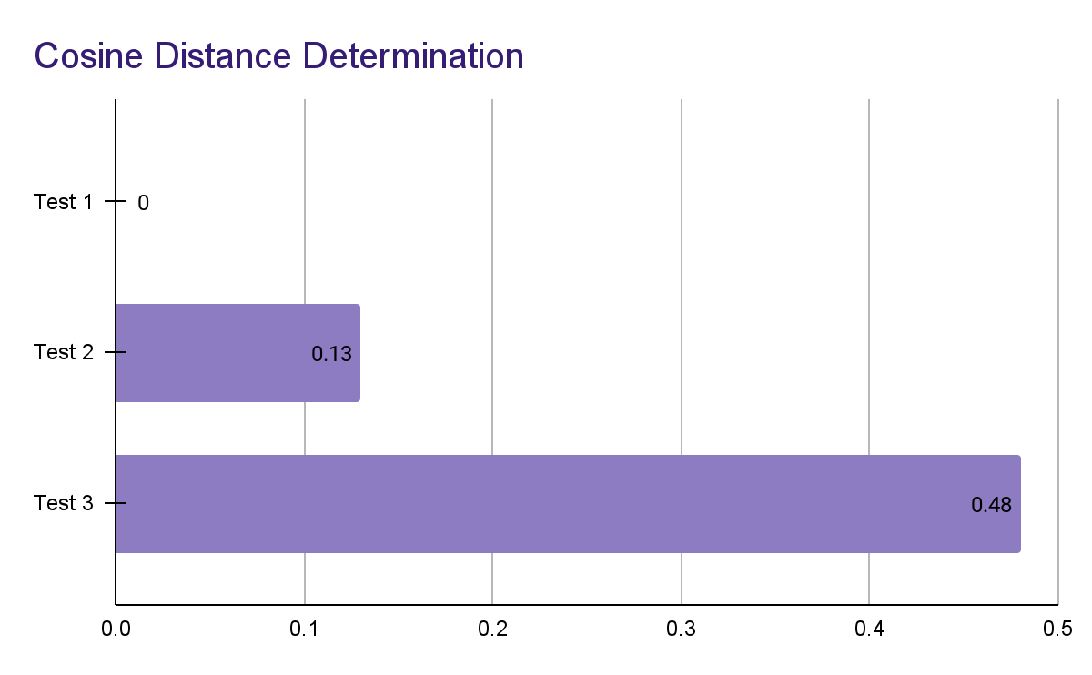
Cosine Distance
0.0
0.13
0.48

Slide 20
Performance Metrics (Emotion Detector)
85.31
88.47
0.824
0.870
0.811
0.837
0.817
0.852
75.75
86.12
0.743
0.869
0.743
0.779
0.742
0.813
71.59
66.87
0.853
0.639
0.486
0.649
0.490
0.642
88.84
0.854
0.853
0.854

Slide 21
Prediction (Emotions)
Input Text: I like playing football.
Predictions:
Models | Emotion
Support Vector Machine (SVM) | Joy
Logistic Regression | Joy
Random Forest | Anger
XGBoost Classifier | Neutral
Multinomial Naïve Bayes | Neutral
Decision Tree Classifier | Joy
Multilayer Perceptron (MLP) | Joy
Final Prediction (Best Emotion):
Joy

Slide 22

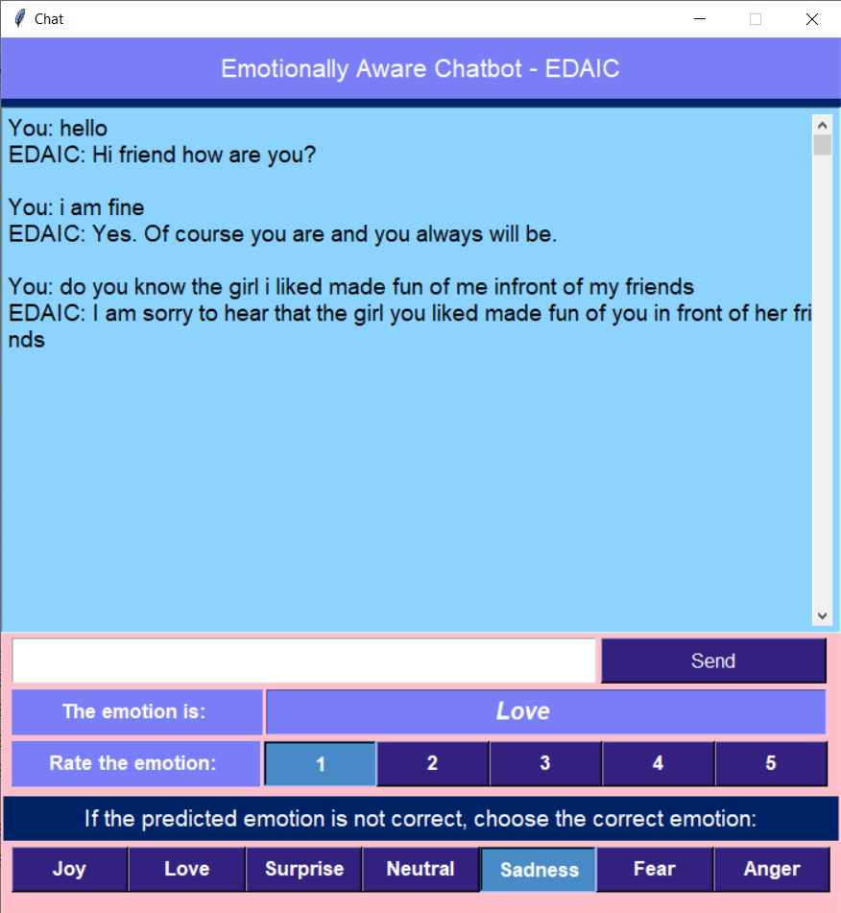
Reply Generation and Emotion Feedback

Slide 23
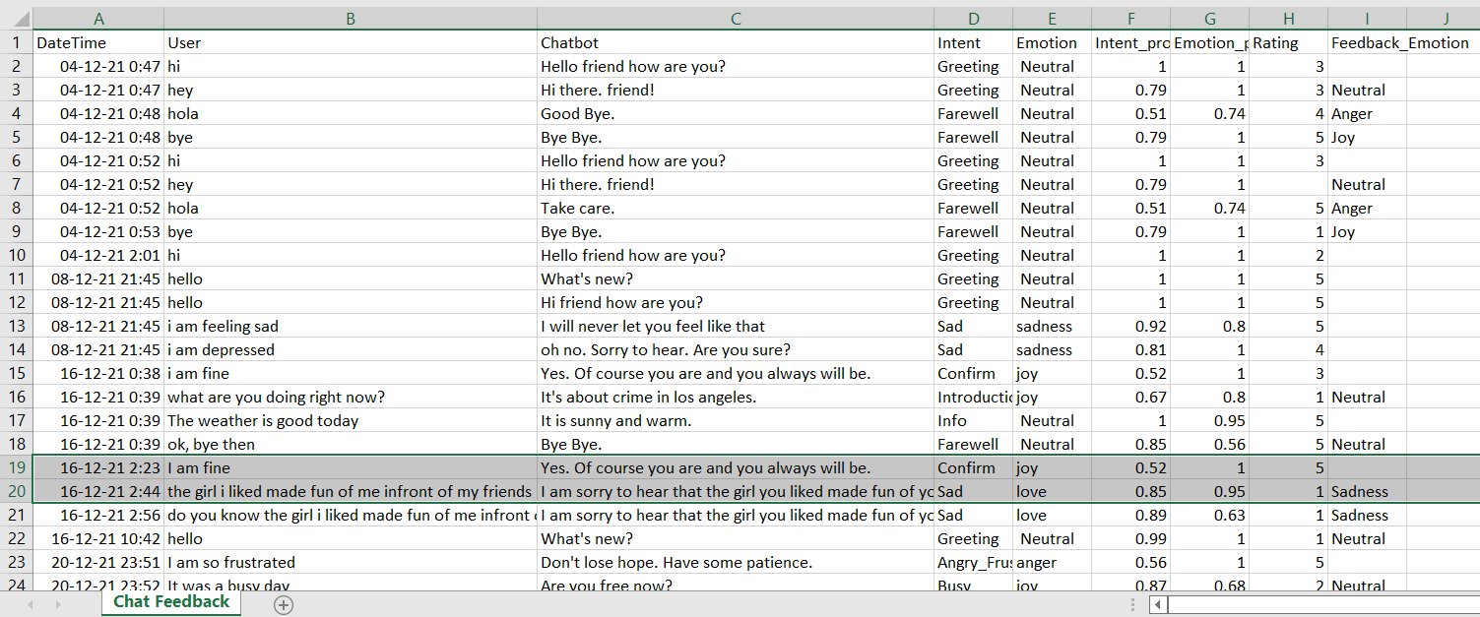
Emotions Feedback (Stored Data)

Slide 24
Conclusion
1. Textual Analysis and Emotions Detection while chatting
2. Seven Models - Implemented and Compared
3. Highest Accuracy
Chatbot - SVM Model (71.71% )
Emotion Detector - XGBoost Model (88.84% )

Slide 25
Future Works
Accuracy Improve
Balanced Dataset
Self-Learning
Chatbot

Slide 26
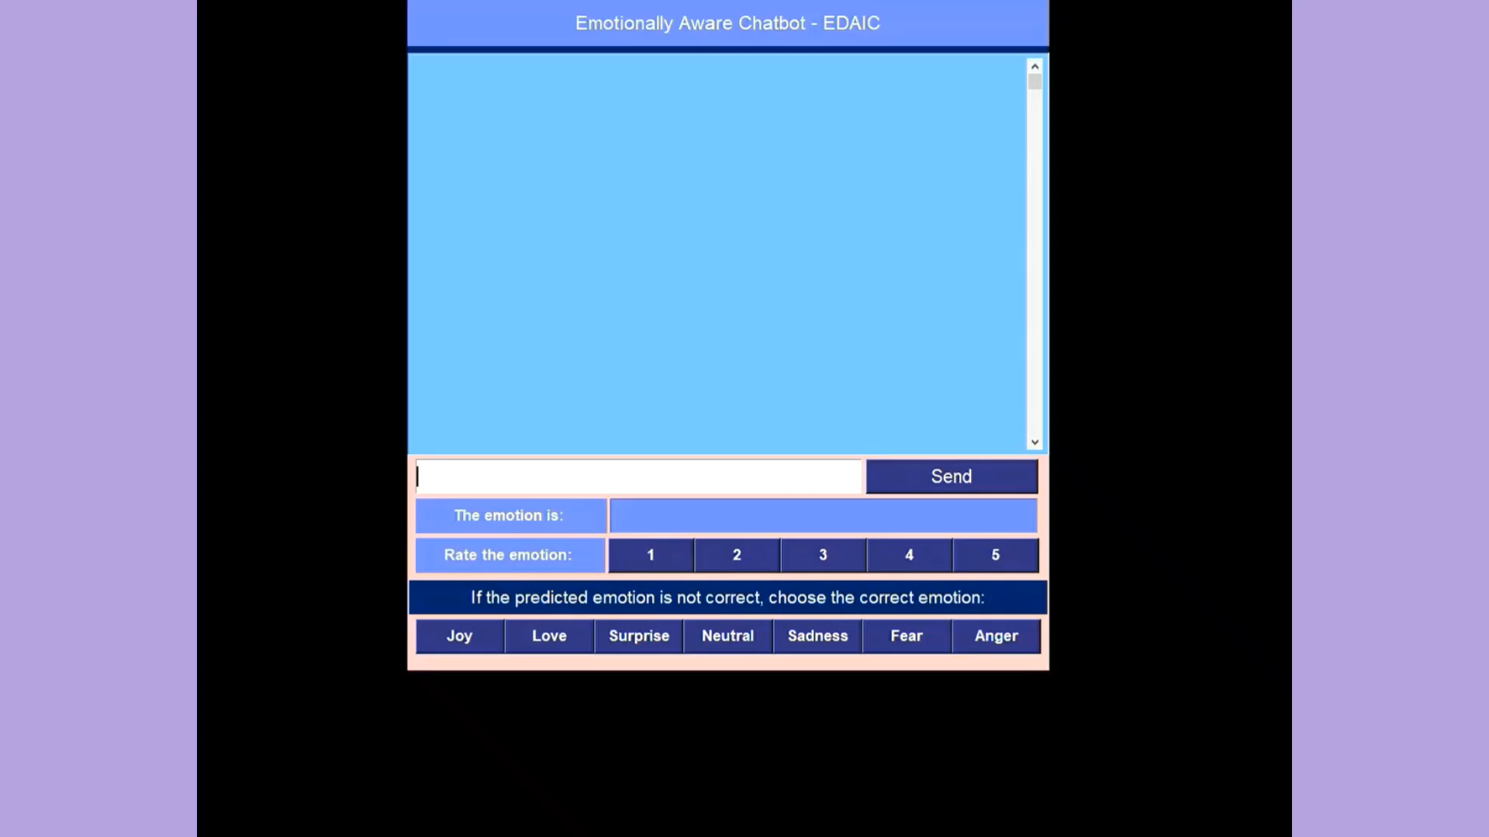
Demo

Slide 27
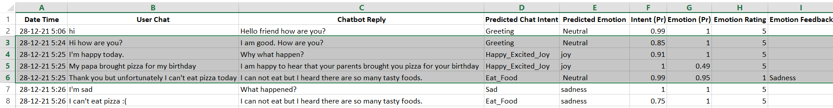
Demo (Stored Data)

Slide 28
Thank You

Slide 29
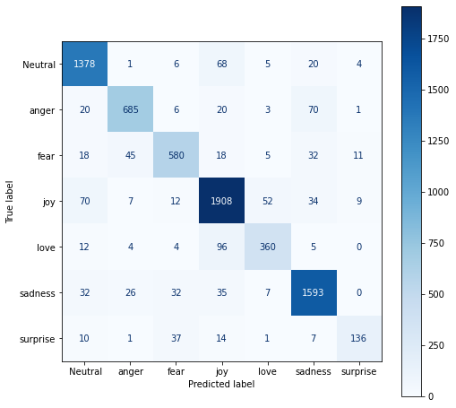
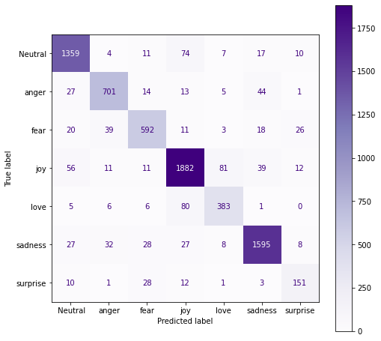
Confusion Metrics (Emotion Detections)
Fig: Support Vector Machine
Fig: XGBoost Classifier

Slide 30
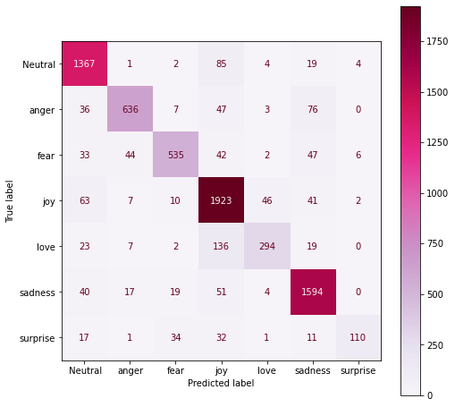
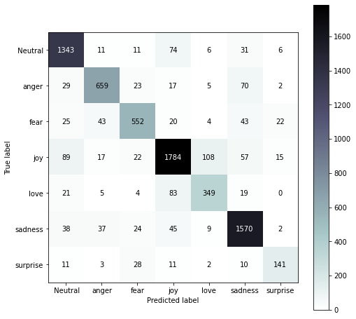
Confusion Metrics (Emotion Detections)
Fig: Logistic Regression
Fig: Multilayer Perceptron

Slide 31
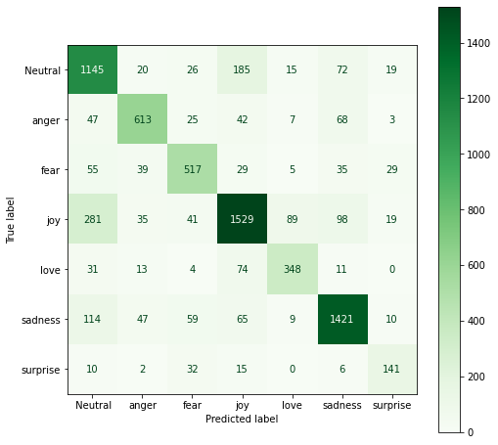
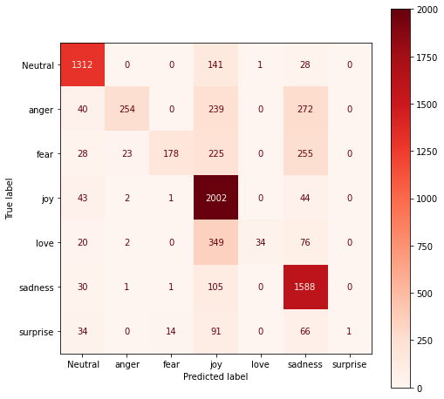
Confusion Metrics (Emotion Detections)
Fig: Decision Tree
Fig: Multinomial Naïve Bayes

Slide 32
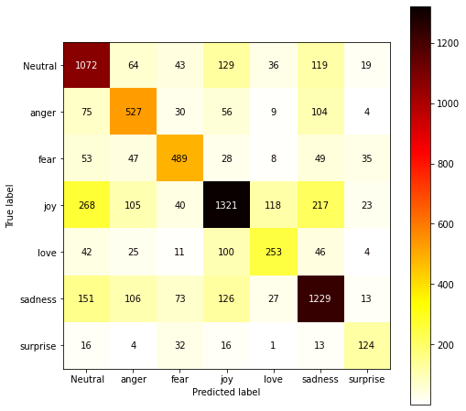
Confusion Metrics (Emotion Detections)
Fig: Random Forest

Slide 33
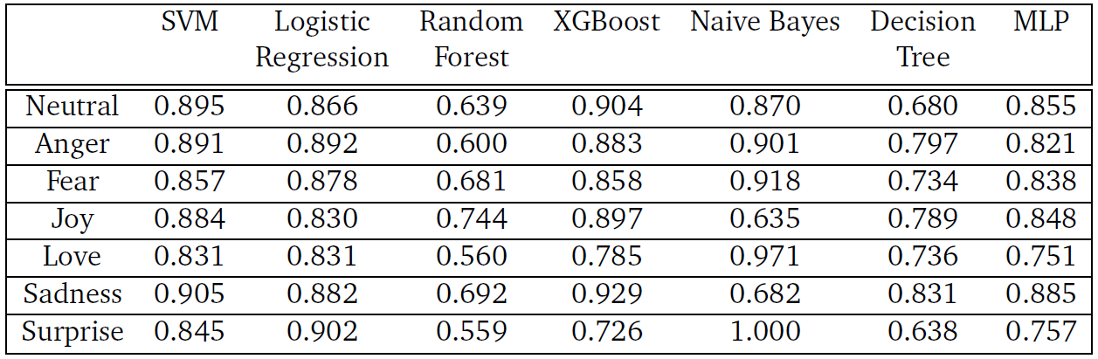
Precision Table
Fig: Precision of All Models for Every Emotions

Slide 34
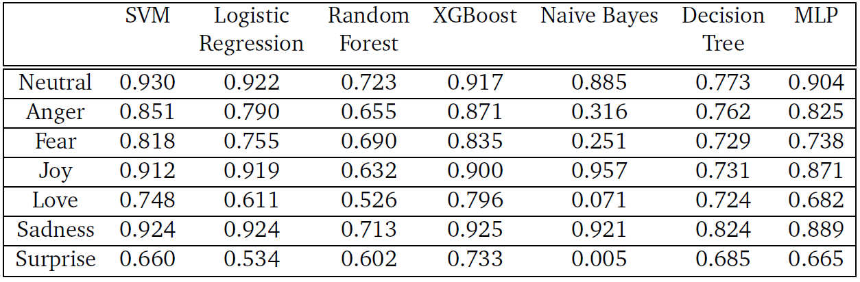
Recall Table
Fig: Recall of All Models for Every Emotions

